Slide 1
The Fine Guidance Sensor (FGS)
&
the Near-Infrared Imager and Slitless Spectrograph (NIRISS)
JWST FGS
René Doyon, Université de Montréal
& the FGS science team

Slide 2
FGS in brief
Two instruments in one box provided by CSA
FGS-Guider
  Provides fine guiding to the observatory
  0.6-5 μm IR camera. No filters, single optical train with two redundant detectors each with a FOV of 2.3’x2.3’
    Noise equivalent angle (one axis): 3.5 milliarcsec
    95% sky coverage down to J_{AB}=19.5
Science camera module. Used to be the Tunable Filter Imager (TFI).
  Narrow band imaging between 1.5 and 5.0 μm
  Based on a low-order Fabry-Perot
  Main science drivers
    First Light: Lyα emitters at z > 11.3 (1.5 μm)
    Exoplanet detection and characterization

Slide 3
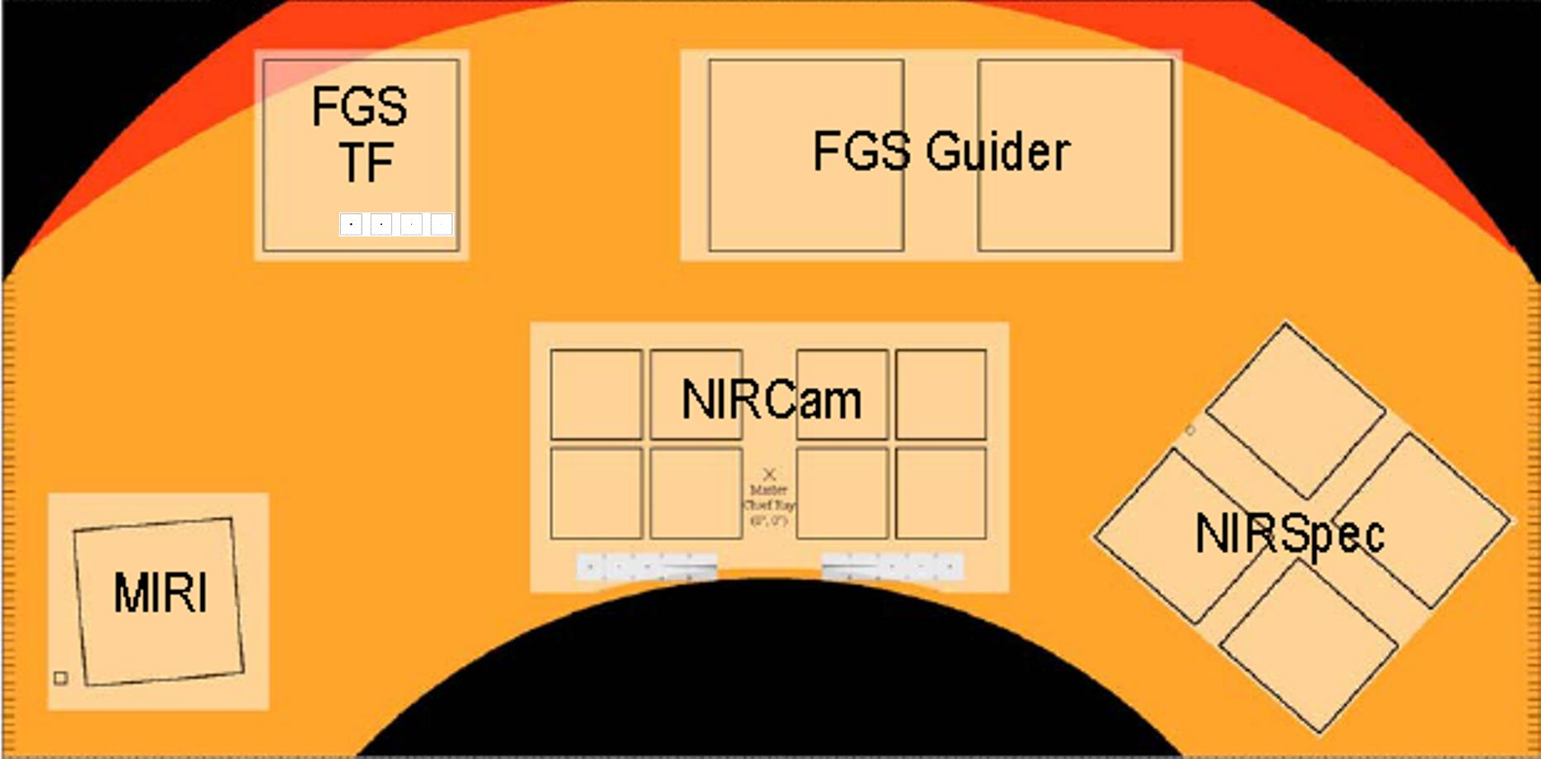
FOV Location

Slide 4
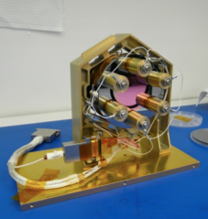
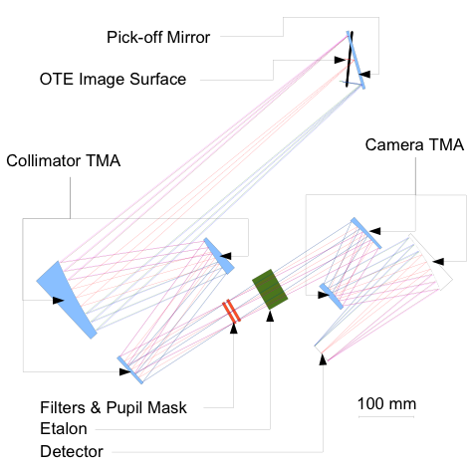
TFI/NIRISS Optical Design
Haley et al [8442-133], Space environment challenges with the tunable Fabry-Perot etalon for the JWST fine guidance sensor

Slide 5
Transition plan from TFI to NIRISS
Remove etalon and related control electronics
Re-populate dual wheel (9 position each) with new optical elements (filters and grisms)
  Borrow 10 NIRCam spare filters
New procurements:
  6 fiters
  Two low-resolution grisms
  One crossed-dispersed grism
Qualification plan of new components
  Radiation tests, cryo cycling, WFE characterization at ambient and cryo, grism efficiency.
Test plan
  DW: functional test at cryo + vibration test.
  No end-to-end instrument tests (to be done at ISIM).

Slide 6
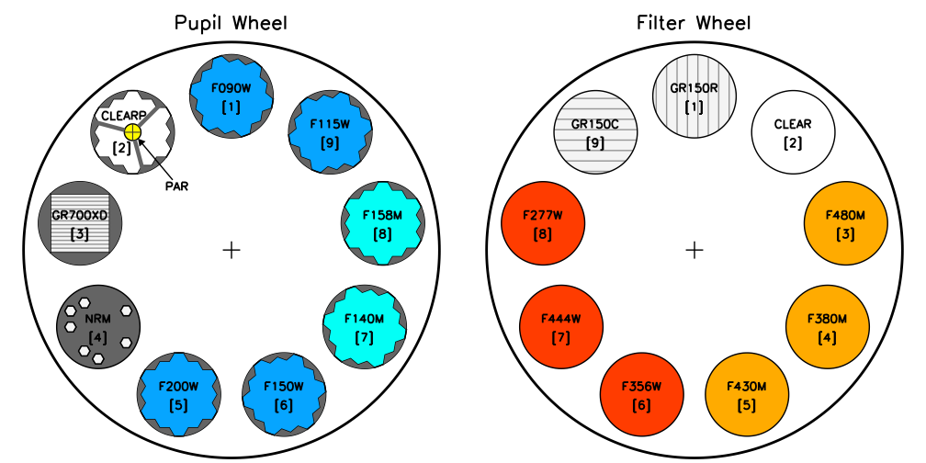
NIRISS Dual Wheel components

Slide 7
NIRISS Observing modes
Wide-Field Slitless Spectroscopy (WFSS)
  Optimized for Lyα emitters
  Wavelength range: 1 – 2.5 μm
  Spectral resolution: 150
  Line flux sensitivity requirement (10σ 10⁴s): 6.25x10⁻²¹ W m⁻² at 1.4 μm with F140M filter.
  Spectro-photometry accuracy: 10%
Aperture Masking Interferometry (AMI, high-contrast imaging)
  Wavelength range: 3.8 – 4.8 μm.
  Three medium-band (5-8%) filters.
  Contrast: 10⁻⁴ between 70 and 500 mas on 5th star at 4.8 um.
Single-Object Slitless Spectroscopy (SOSS)
  Optimized for relatively bright stars (e.g. exoplanet transiting systems).
  Wavelength range: 0.6 – 2.5 μm
  Spectral resolution: 700 at 1.25 μm
  Brightness limit: J=7 (J=5; goal)
Broad-band imaging (BBI; parallel observing mode; goal)
  7 NIRCam filters: F090W, F115W, F150W, F200W, F277W, F356W, F444W
  Open (could be used in guide mode)

Slide 8
Broad-band imaging

Slide 9
Broad-band imaging

Slide 10
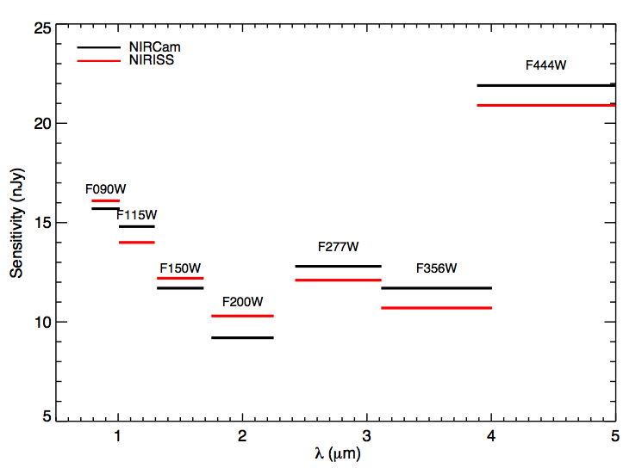
NIRISS broad band sensitivity (10σ, 10⁴ sec)
Very similar sensitivity to NIRCam within 5-10%

Slide 11
Wide-Field Slitless Spectroscopy

Slide 12
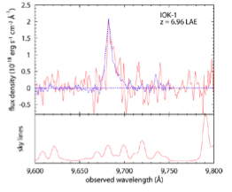
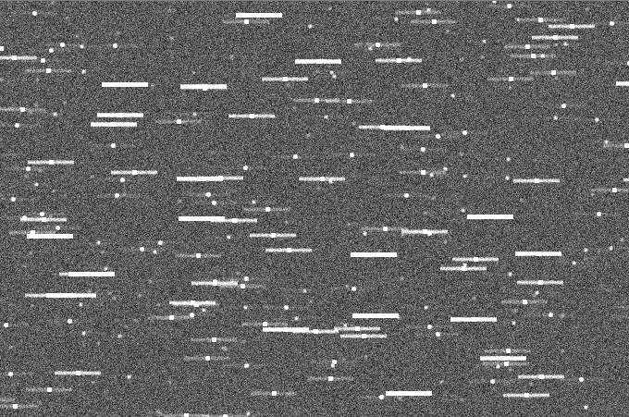
Slit less spectroscopy with two grisms
λ
λ
A spectrum for every source in the field of view.
No need for pre-imaging for selecting objects.
Slitless mode is less efficient as background is higher.
Spatial location
at intersection point

Slide 13
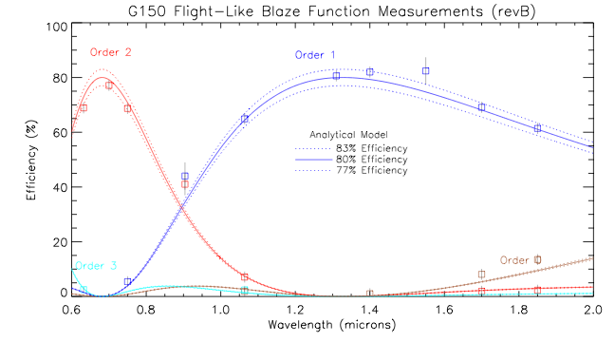
G150 measured efficiency

Slide 14
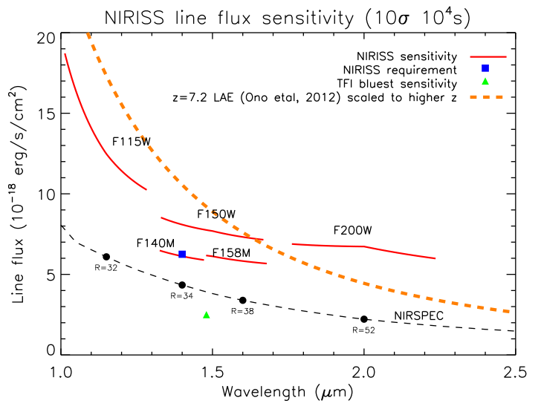
NIRISS sensitivity - WFSS
Universe reionized here according to 7-yr WMAP data

Slide 15
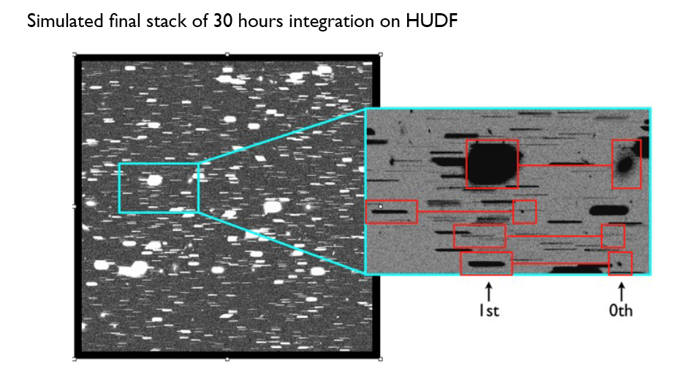
WFSS HUDF Simulations
Fraction of pixels with S/N>5: 10%
Credit: Chris Willott

Slide 16
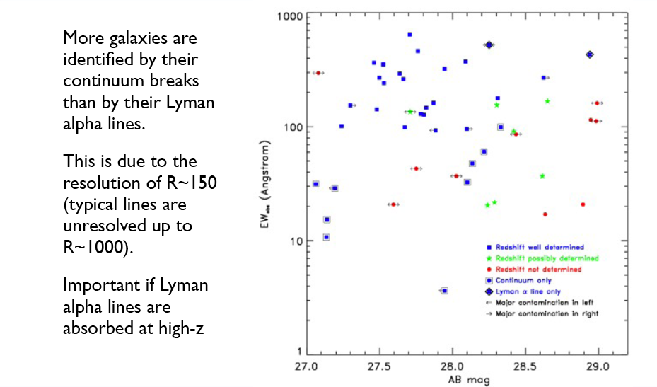
WFSS HUDF Simulations

Slide 17
Aperture Masking Interferometry

Slide 18
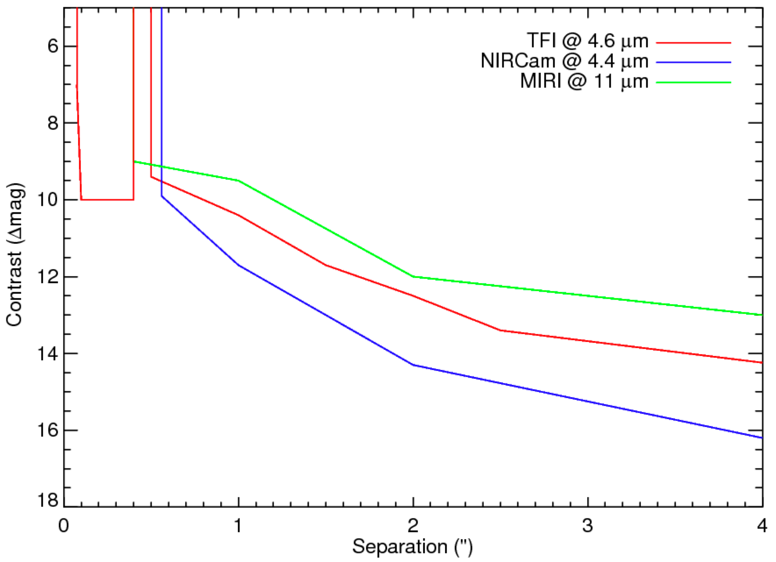
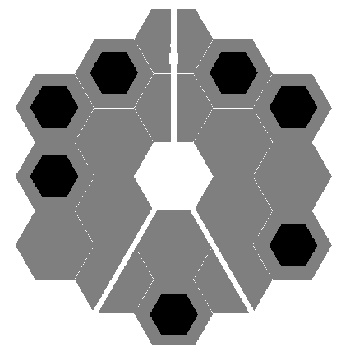
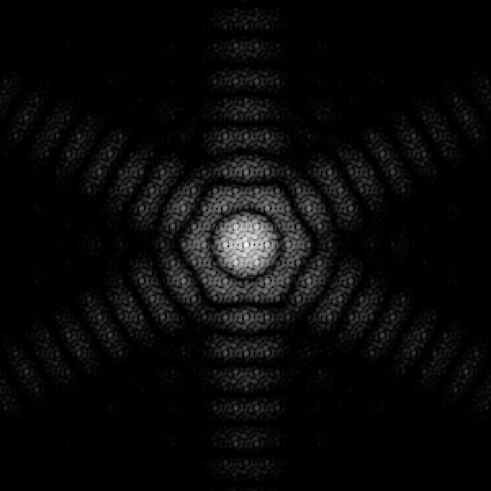

NIRISS Non Redundant Mask will push JWST’s angular resolution to its limit
Bright planets
goal
Faint planets
Beichman et al 2010

Slide 19
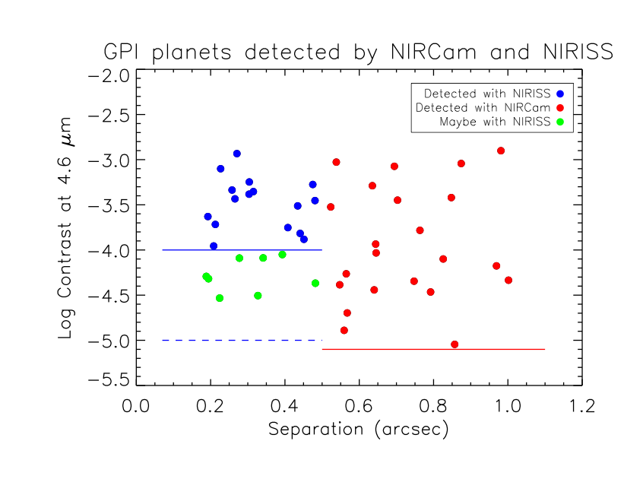
Unique NRM discovery space hardly accessible from the ground

Slide 20
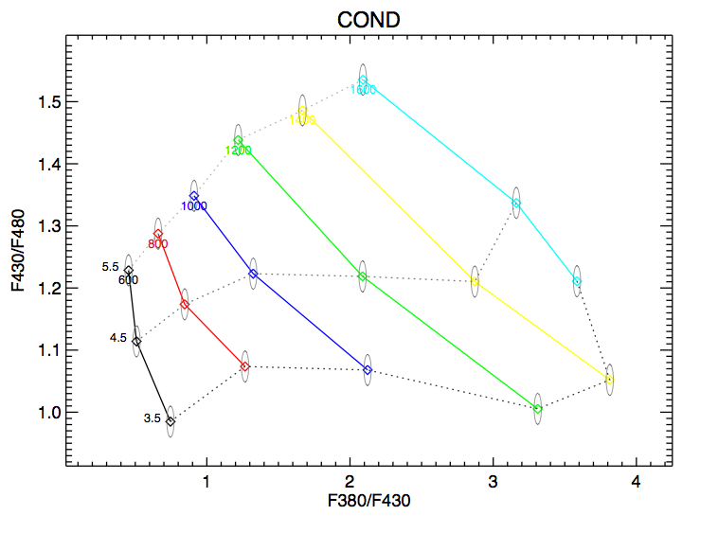
NRM filter set (3)
Good diagnostic diagram for constraining both temperature and gravity

Slide 21
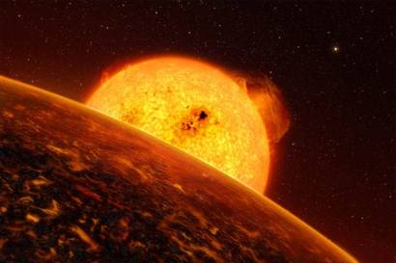
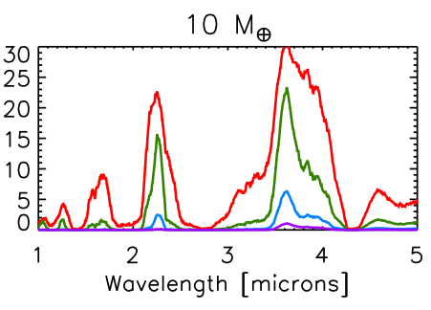
Rocky planets in formation
  Some collisions energetic enough to melt young rocky planet
  Outgassing creates a thin atmosphere ➔ planet can stay molten (at >1000 K) for several Myrs, i.e. observable
    Region of interest <0.5” (few AUs)
    Contrast of <10 mag for young late-type
    stars and brown dwarfs in nearby young associations.
NRM filter set
CO₂
Miller-Ricci et al. 2009

Slide 22
Single Object Slitless Spectroscopy

Slide 23
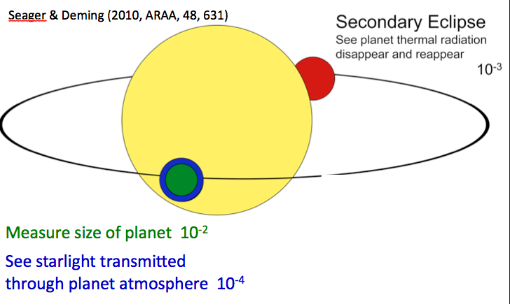
Schematic of Transit and Eclipse Science
Notes:
Cartoon of observational technique.

Slide 24
G700XD efficiency
Total system’s throughput: ~15%

Slide 25
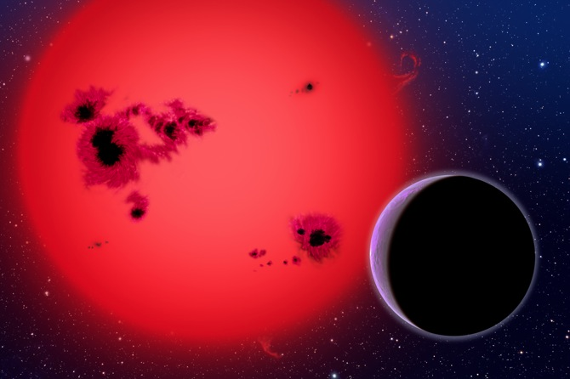
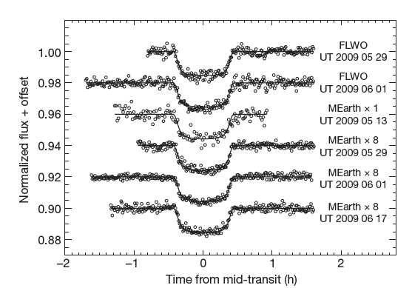
NIRISS simulation of the transiting super-earth GJ1214b (Credit: David Lafrenière)
Charbonneau et al 2009, Nature, 462, 17
 | GJ1214b | Earth | Neptune
Mass | 6.5 | 1.0 | 17
Radius | 2.7 | 1.0 | 4.0
Temperature (Kelvin) | 400-600 | 300 | 55
Density (g/cm³) | 1.9 | 5.5 | 1.7
What is the nature of GJ1214b?
An ice giant (a mini Neptune) ?
A water world ?
Transit spectroscopy can give the answer

Slide 26
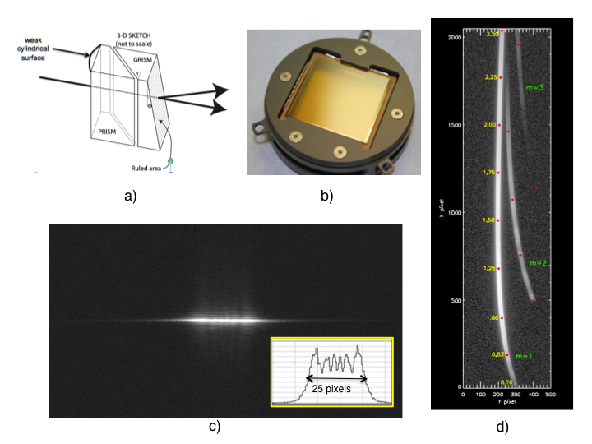

Slide 27
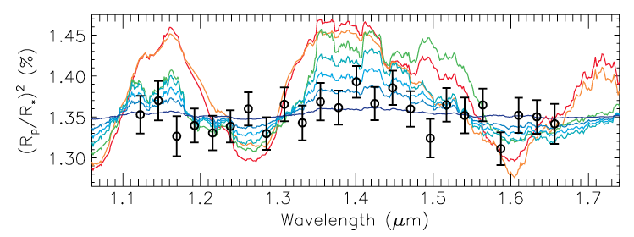
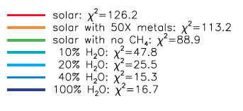
GJ1214b as observed by HST
Berta et al 2012

Slide 28
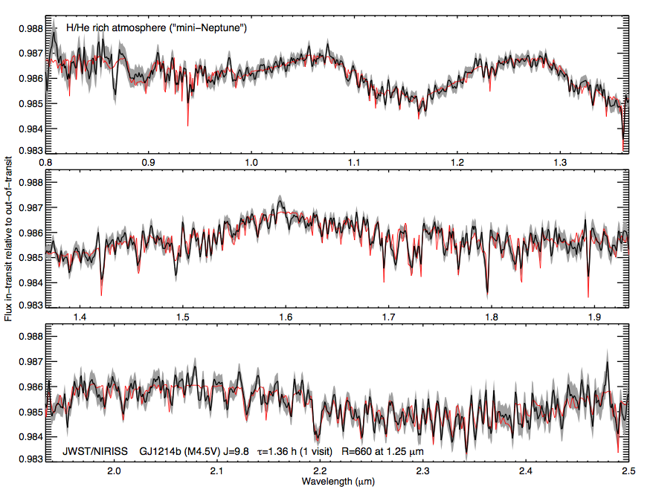
With NIRISS (mini-Neptune model)
Integration time: 80 mins (twice the transit time; one visit)
Notes:
Red line is model from Miller-Ricci & Forthner (2010).
Black model is extracted spectrum.
Grey envelope is the one sigma error bar.

Slide 29
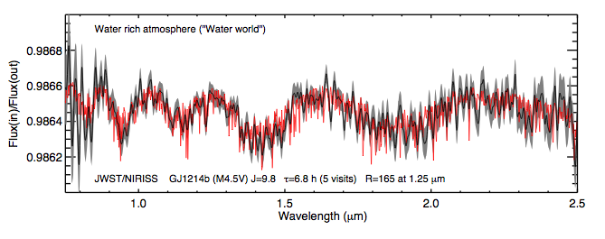
With NIRISS (« Water world » model)
Integration time: 6.8 h (5 visits)

Slide 30
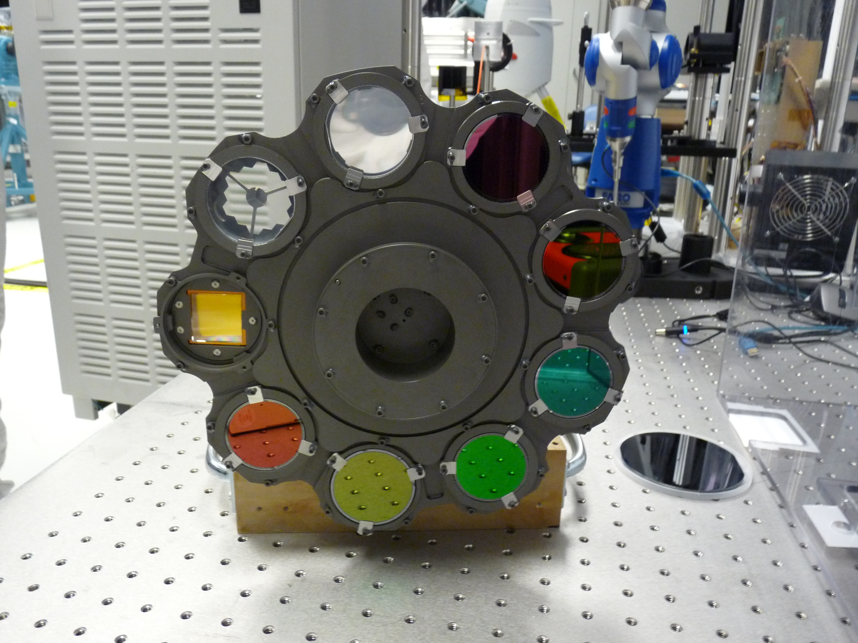

Slide 31
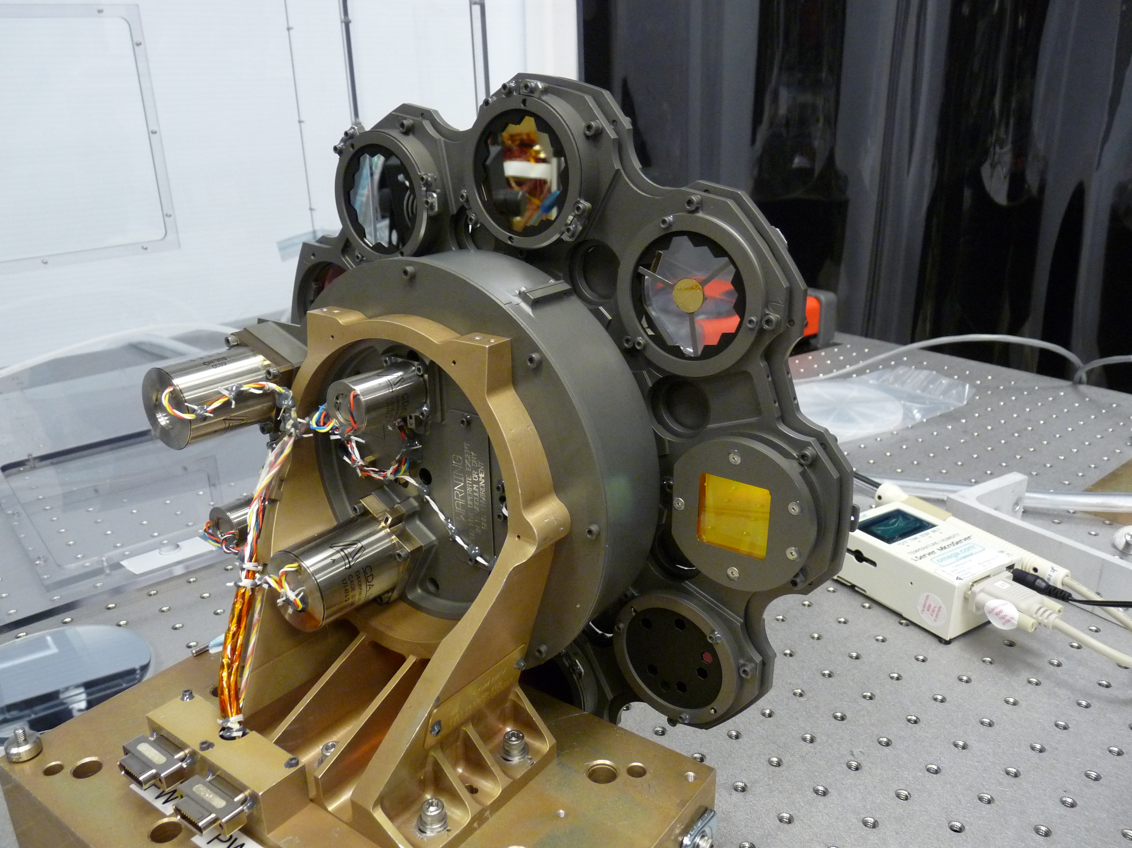

Slide 32
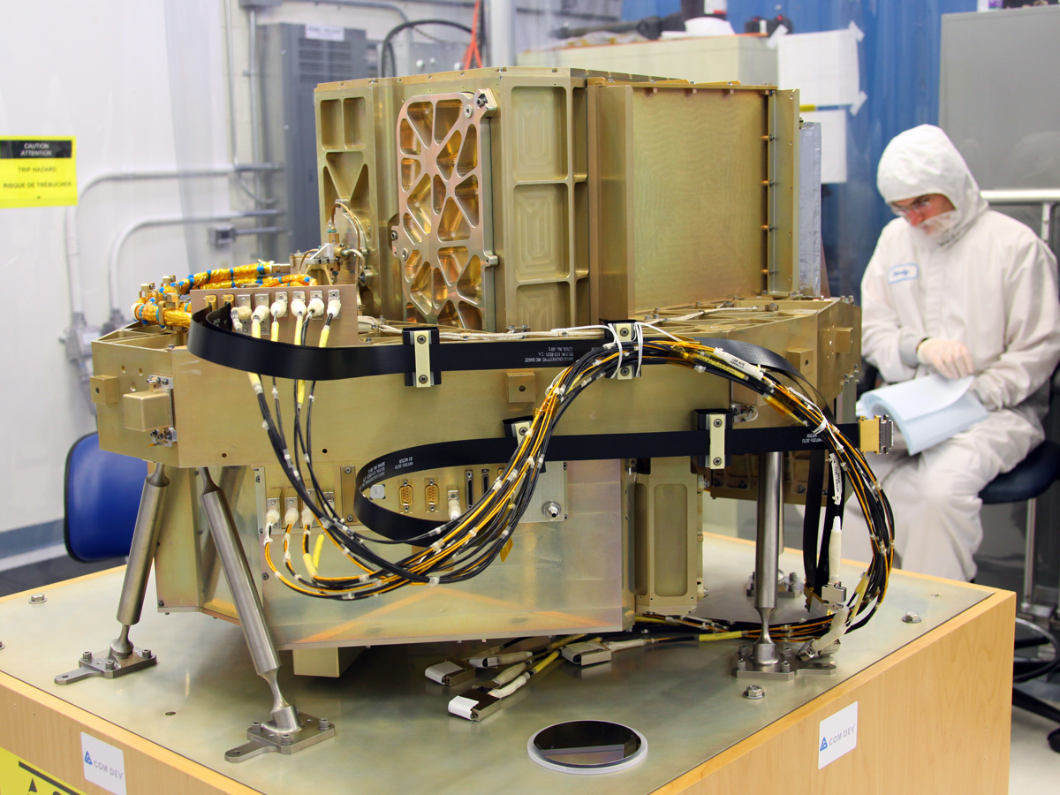

Slide 33
Summary
JWST has a new instrument called NIRISS with the following cababilities:
  Broad band imaging (could be configured as a guiding channel)
  Low-resolution (R=150) multi-objet slitless spectroscopy
  Very high contrast imaging
  High-dynamic range R-700 slitless spectroscopy optimized for transiting exoplanets.
FGS/NIRISS shall be on dock at GSFC by the end of this month.

