Slide 1






James Webb Space Telescope Optical Telescope Element (OTE) Mirror Coatings
Ritva. A. Keski-Kuha, Charles W. Bowers, Manuel A. Quijada
NASA/Goddard Space Flight Center
James B. Heaney, SGT Inc. Greenbelt
Benjamin Gallagher, Ball Aerospace & Technologies Corp
Andrew McKay Northrop Grumman Aerospace Systems
Ian Stevenson, Quantum Coating Inc.

Slide 2
Outline
Introduction
Coating Qualification Program
Flight Mirror Results

Slide 3
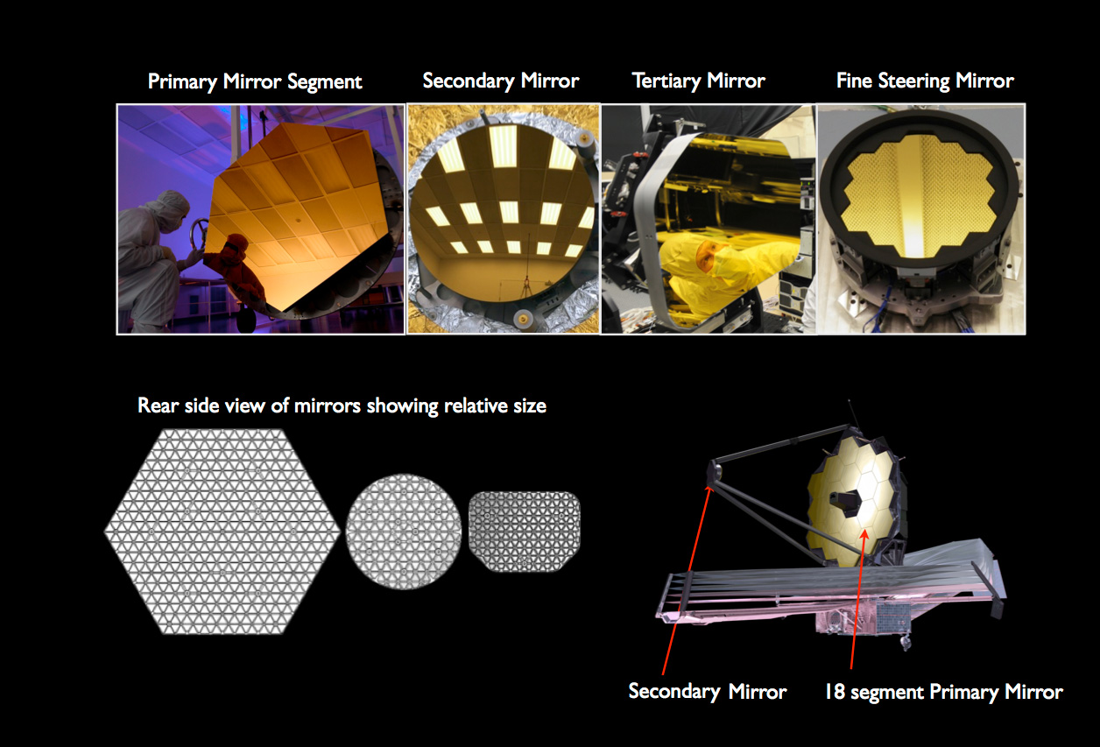
JWST Optical Telescope Element
(OTE) Mirrors
Mirror | Size | Figure
Primary Mirror | 6.5 m aperture f/1.2 | Elliptical
PM Segments | 1.52 m point to point
Secondary Mirror | 0.738 m diameter | Hyperbolic
Tertiary Mirror | 0. 513 m x 0.709 m | Elliptical
Fine Steering Mirror | 0.17 m diameter | Flat

Slide 4
Key Requirements
High reflectivity over the JWST spectral range (800 nm – 29 µm) to maximize the throughput of the telescope
Low stress
Compatible with substrate material
Survive environmental conditions on the ground and cryogenic operating environment
Wavelength (µm) | Reflectance Requirements (%)
0.8 | ≥ 94.1
1.0 | ≥ 96.3
1.5 | ≥ 97.4
2.0 -20.0 | ≥ 97.9
20.1 – 27.0 | ≥ 97.9
27.1 – 29.0 (Goal) | ≥ 97.9

Slide 5
Coating Qualification Program
Protected gold was selected as the optical coating for JWST OTE
Coating specifications were developed by Ball Aerospace
Quantum Coating Inc. developed and applied the coatings
  Designed and built a new facility to coat the JWST Telescope mirrors
Coating qualified for:
  Reflectance
  Thickness uniformity
  Run to run thickness variation
  Micro roughness
  Durability
  Radiation
  Maintainability
  Coating stress
  Scratch/dig
  Pinholes
  Operational and storage life

Slide 6
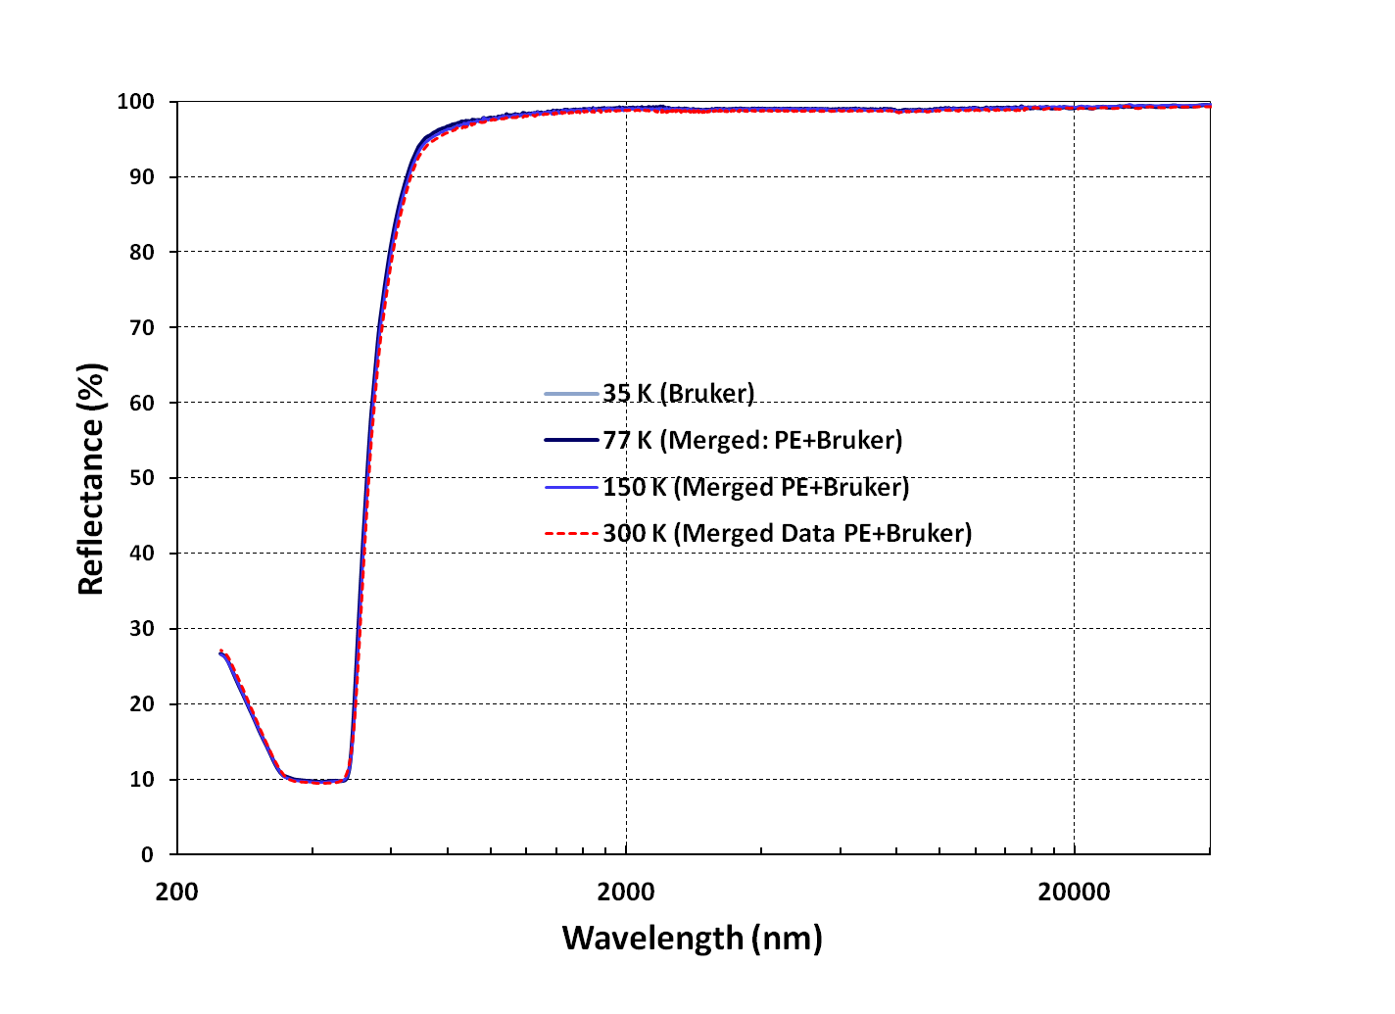
Cryogenic Temperature Reflectance
No change in
reflectivity over
the JWST OTE
wavelength and
temperature
range
Coating Reflectance at Temperatures from 300K to 35K

Slide 7
Radiation Exposure
Objective of the irradiation exposure test was to measure change in reflectivity as a function of exposure to a simulated L2 orbital electron and proton environment
4 samples coated during the coating qualification program were tested at GSFC Solar Wind Facility
Beam energies: 3 keV electrons, 10 keV protons
Reflectance measurements made in-situ before, during and after the radiation exposure

Slide 8
Reflectance of QCI sample G4
Exposed to 2.98E15 protons/cm² at 3keV plus 8.05E14 electrons/cm² at 10keV

Slide 9
Key Non Reflectance Requirements
Coating reflectance and uniformity measured on witness samples distributed across the clear aperture using mirror surrogates met requirements
Surface roughness change less was than noise in the measurement
Coating met the 10 ksi stress requirement. Verified on 2” diameter glass samples and 8” diameter Be sample at ambient and cryo respectively
Humidity exposure, hardness and adhesion met MIL 13830B
10 year operational lifetime
  Accelerated life tests: cryo cycling and 24 hour humidity exposure
  Space flight heritage of protected gold coating: Cassini CIRS instrument primary mirror coated in 1996
    Re-measured a witness sample. Reflectance had not degraded in 12 years between measurements
  Inspection of SBMD mirror coated in 2001: the mirror does not show any degradation

Slide 10
Flight Mirrors

Slide 11
Flight Mirror Coating Program
Mirrors coated in configuration 2 where the actuator assembly is removed to protect the flight actuators from the coating process
  Handling structure used during coating operations
1” diameter Be witness samples demonstrated successful coating on each mirror
11 samples coated with each mirror
  Witness samples located outside mirror clear aperture
  6 witness samples tested at QCI to demonstrate coating performance
    Reflectance measured after cryogenic temperature cycling and humidity exposure
  5 installed in the shipping container with the mirrors
    2 stored in a dry box at Ball
    3 witnessed integration and test operations including cryogenic testing at XRCF

Slide 12
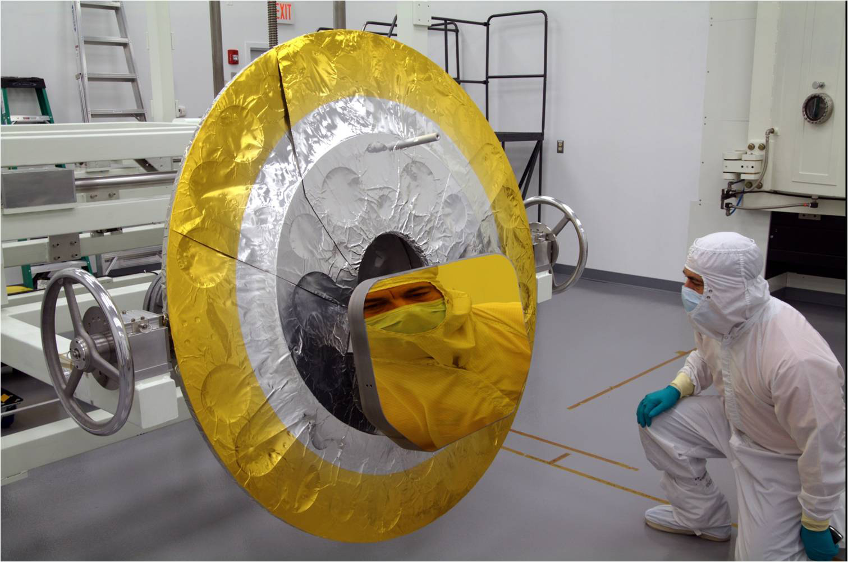
Tertiary Mirror

Slide 13
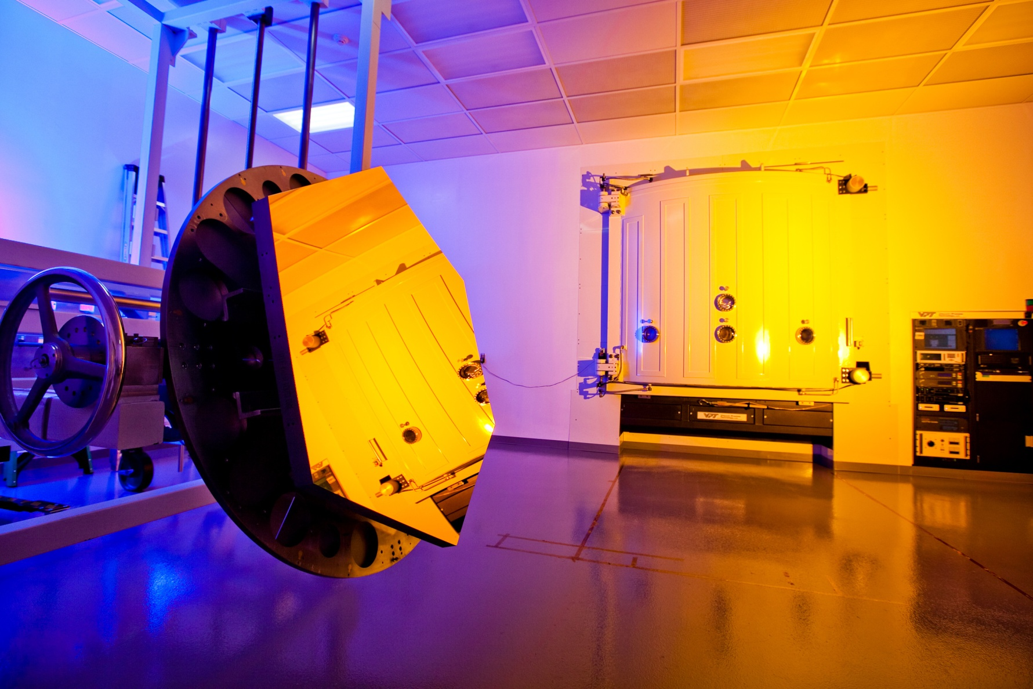
The Engineering Development
Unit (EDU) primary mirror segment
Coated in gold by Quantum Coating Incorporated

Slide 14
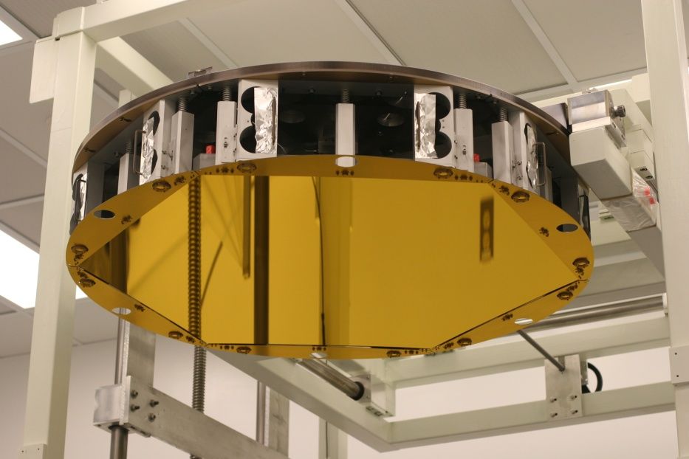
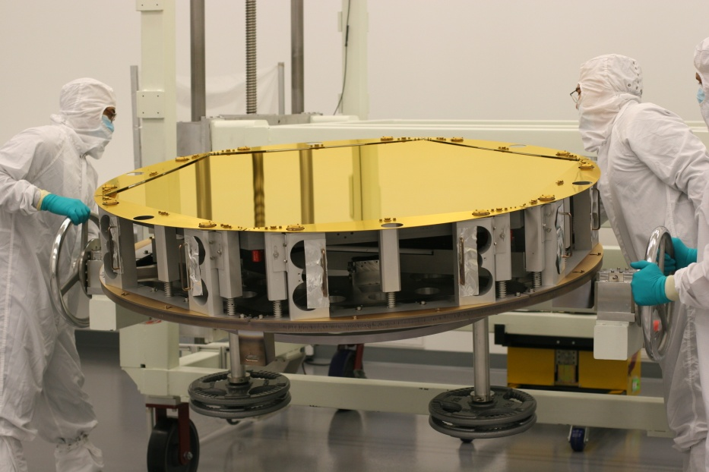
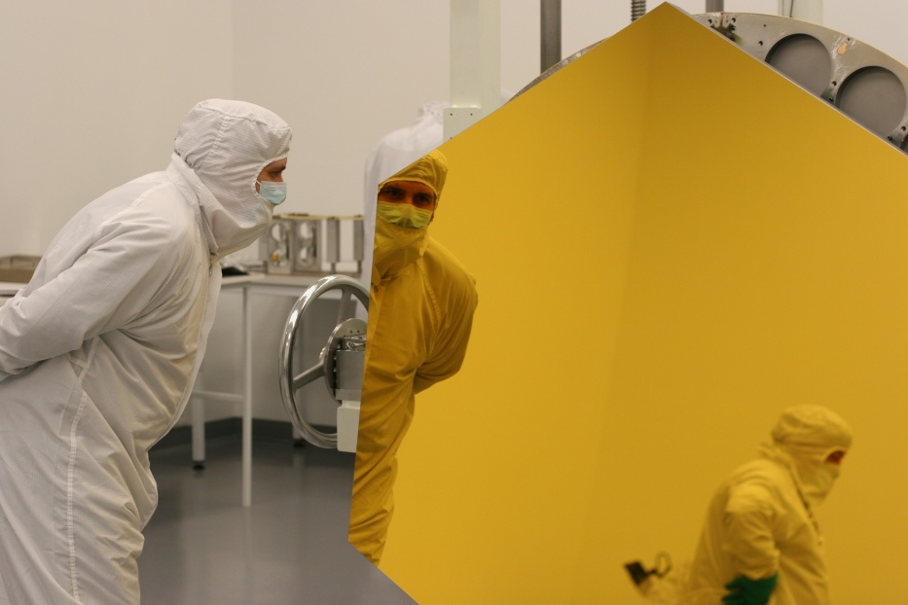
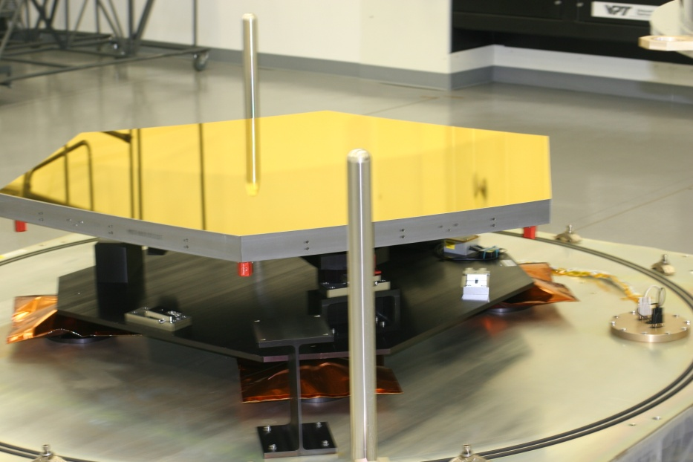
Primary Mirror Segment
Assembly A5

Slide 15
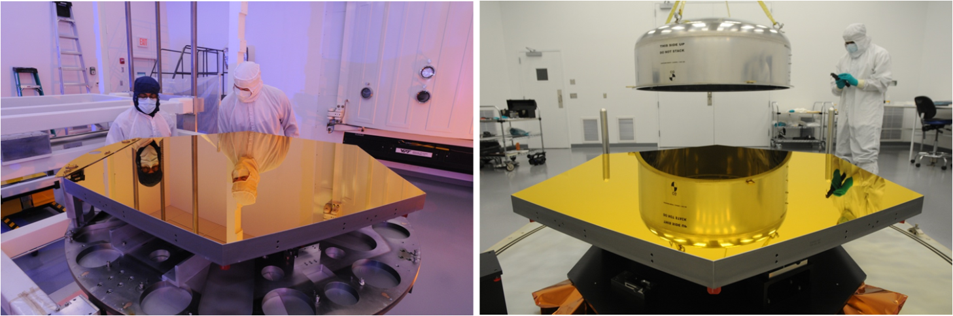
Primary Mirror Segment Assembly B6
PMSA B6 in the coating fixture and being readied for shipment to BATC.

Slide 16
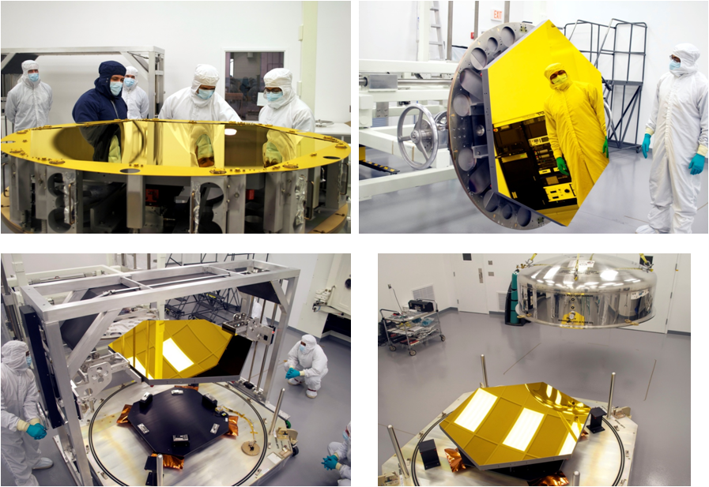
Primary Mirror Segment Assembly C3
PMSA C3 in the coating fixture with the mask on, the mask removed (top pictures)
and being readied for shipment to BATC.

Slide 17
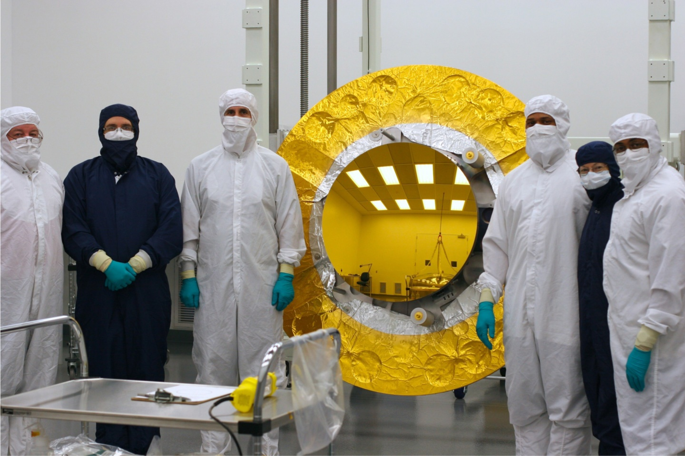
Secondary Mirror

Slide 18
PMSA A1 Reflectance Results
Wavelength (µm) | Reflectance Requirement(%) | Measured Reflectance (%)
0.8 | ≥ 94.1 | 96.0
1.0 | ≥ 96.3 | 97.3
1.5 | ≥ 97.4 | 98.0
2.0 -20.0 | ≥ 97.9 | 98.5 – 98.8
20.1 – 27.0 | ≥ 97.9 | 99.08 – 99.42
27.1 – 29.0 (Goal) | ≥ 97.9 | 99.16 – 99.35

Slide 19
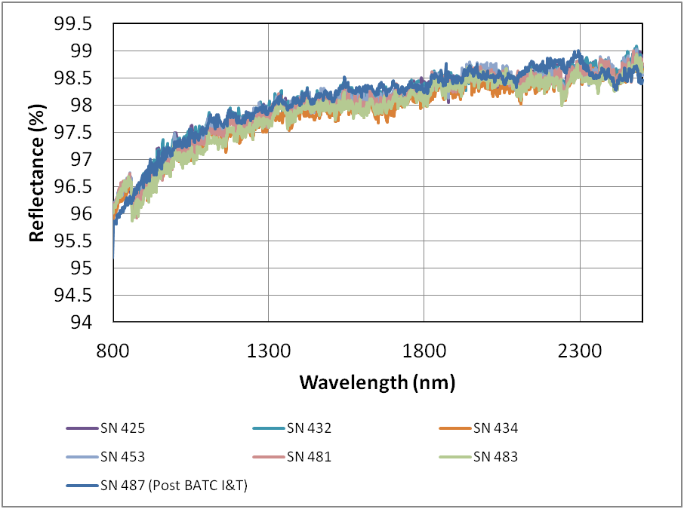
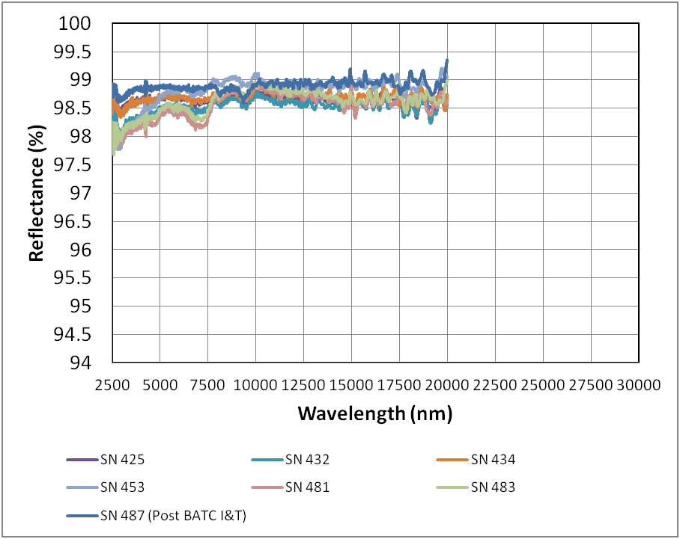
PMSA A1 Run Reflectance
Post BATC I&T Sample compared to 6 QCI Acceptance Samples.

Slide 20
Reflectivity of the JWST Mirrors and the Throughput of the Telescope.

Slide 21
JWST Telescope Mirrors

Slide 22
Summary
Completion of coating the mirrors was a major milestone in the development of JWST Optical Telescope Element.
The coating program was completed on schedule with excellent results.
The large size of the JWST telescope primary mirror segments was a major challenge that was overcome successfully.
The extensive coating development program over a two year period before coating was key to the successful program.
Success ensures the scientific discovery potential of James Webb Space Telescope.

